Slide 1
Blogs, Wikis, and Apps, Oh My: Successfully Meeting Resident and Residency Program Technology Needs with Collaborative Media
Dave Ewart, Mark Tuttle, Faisal Rhaman, Chen Wu, and Gina Huss
More information on MedicineInnovation.com

Slide 2
Blogging For Your Residents
The Creighton Experience
Gina Huss & Mohsin Mirza

Slide 3
Our Story: The Inspiration
Great presentation by UW chief residents on blogging as part of their program at APDIM 2014-2015

Slide 4
How do you start?
Contact your IT department
Plugin about Plugins
Decide on content for your program
WordPress format:
https://wordpress.org/
Org vs Com
Notes:
Go over what you did
I got a good contact at IT(IT guy)
I was told that we have a great wordpress platform
I had a few options to pick based on style
I picked a style and with help of IT came up with a good design
But before all this I had a bigger picture and rough idea of content

Slide 5
How do you start?
Stage I: Design the blog
Theme/Title
Layout
Content (pages)
Stage II: add users and grant access
Who can view/comment
Different levels of users
Stage III: start posting!
Present to the program about the blog
Create/publish/edit posts
Notes:
Time line(4 weeks) to really design the blog

Slide 6
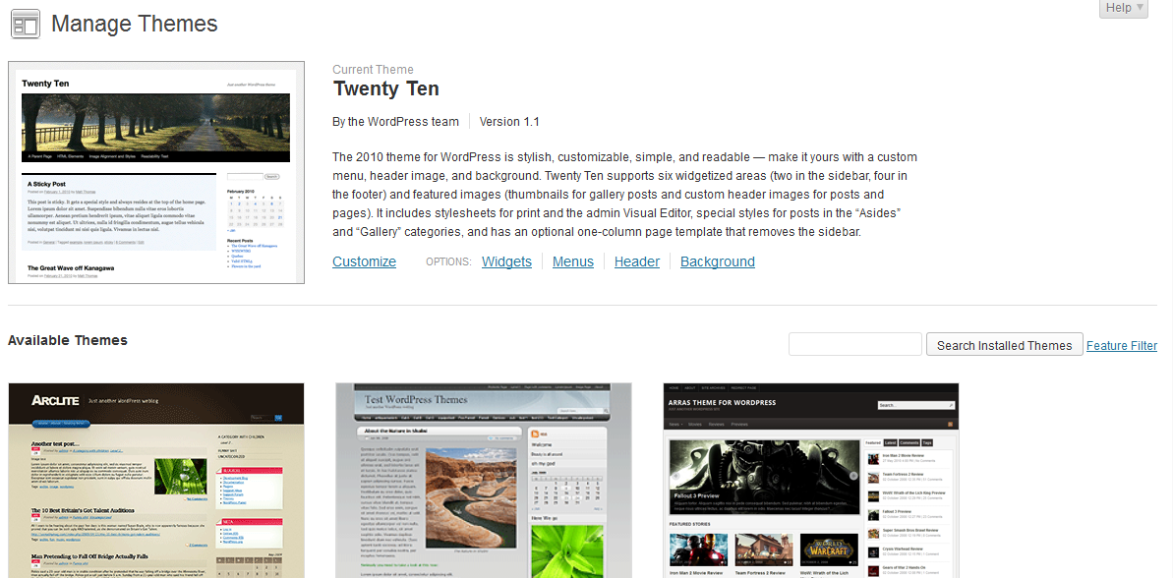
Designing the blog
Choose a theme and modify
Notes:
Choose a theme;use IT staff or residents who are tech savvy to assist with the design
Doing this first is good for morale and envisioning what the blog will look like
Try different themes and personalize(school logo→ billy blue jay, MD)
We used the twenty ten theme
Try different themes and see what they look like.
Chance to unleash creativity

Slide 7
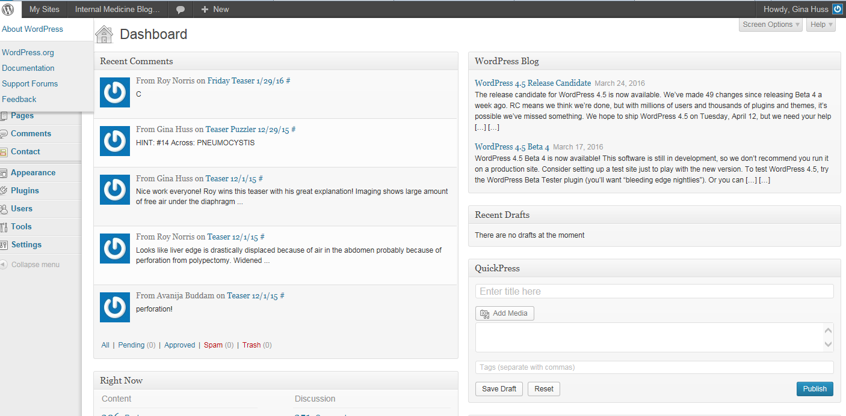
Designing the blog
Layout: Dashboard
Notes:
Describe concept of dashboard→ make edits and construct pages etc.
The Dashboard is where you pick and choose and design

Slide 8
Design the blog
Content: Pages
Notes:
Discuss the concept of pages as being separate sections of the blog
Toggle between site and presentation

Slide 9
Add users/grant access
Administrator: somebody who has access to all the administration features within a single site
Editor: somebody who can publish and manage posts including the posts of other users.
Author: somebody who can publish and manage their own posts.
Contributor: somebody who can write and manage their own posts but cannot publish them.
Subscriber: somebody who can only manage their profile.
Notes:
Describe how each role was assigned
i.e:all residents were contributors
Give suggestions:admin was IT guy and chief

Slide 10
Access:
Notes:
Describe different levels of access and security
Also discuss HIPPA here
Also discuss approval from GME

Slide 11
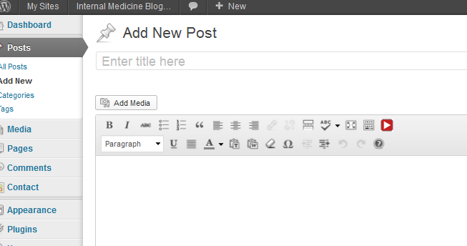
Start posting!
Notes:
Stress importance of adding media

Slide 12
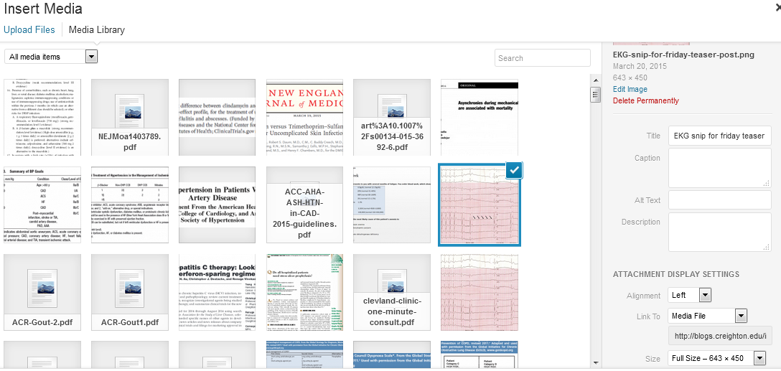
Add media library
Notes:
Stress importance of adding me and using media library to add post.

Slide 13
Tips for posting
Use images!
Bold and underline
Quality, not quantity
Summarize posts at the end
Add links to PDF of references
Avoid long posts
Send reminder emails with hyperlink to blog
Notes:
Stress the importance of brevity
Bold and underline with caution

Slide 14
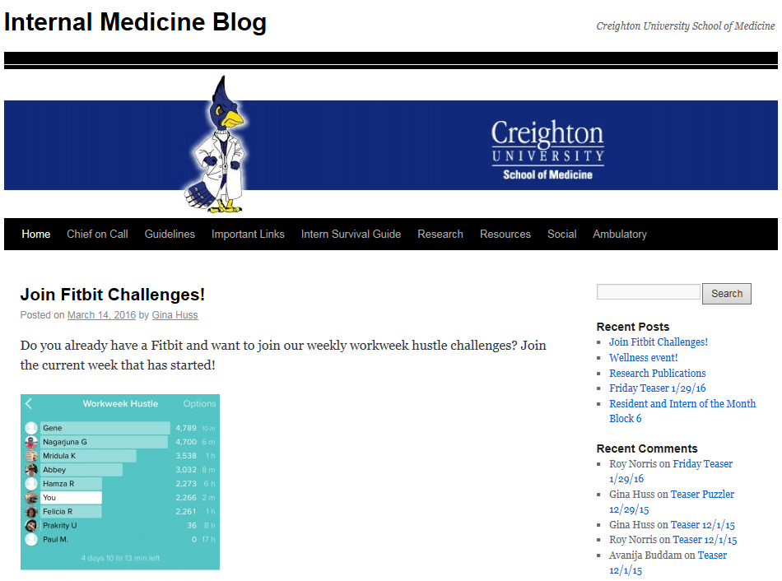
Snap shots: Creighton Blog
Notes:
Discuss content on the home page

Slide 15
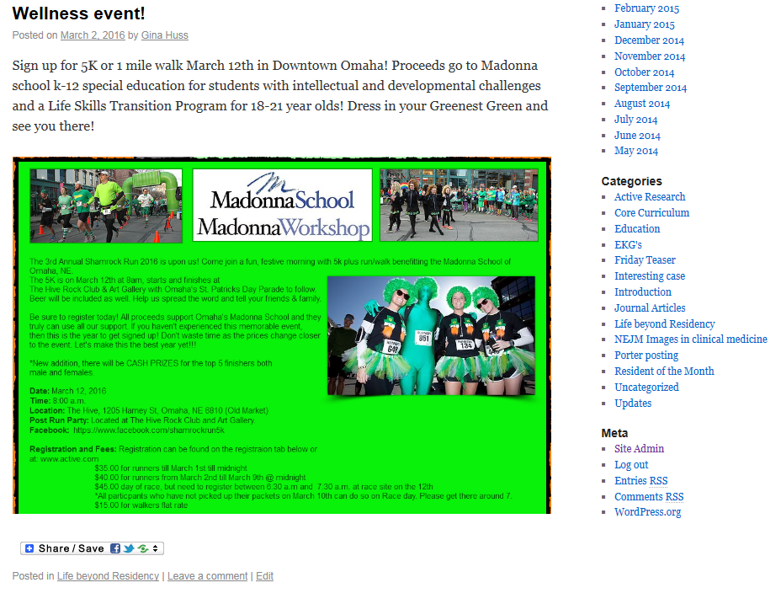
Snap shots: Creighton Blog

Slide 16
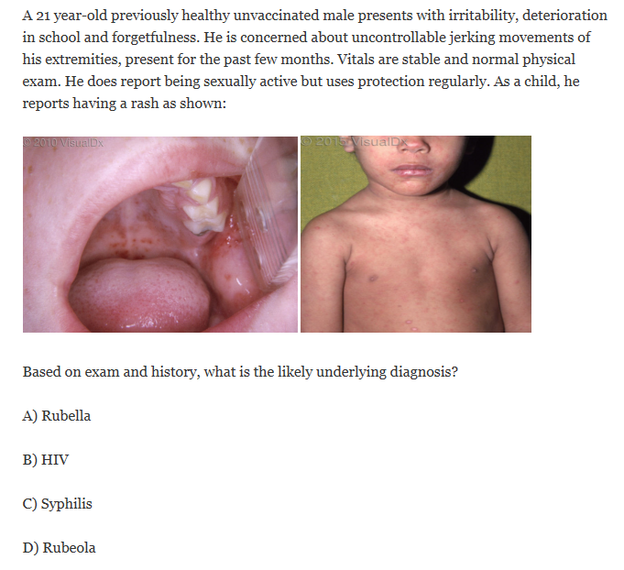
Snap shots: Creighton Blog
Example of Friday Teaser:

Slide 17
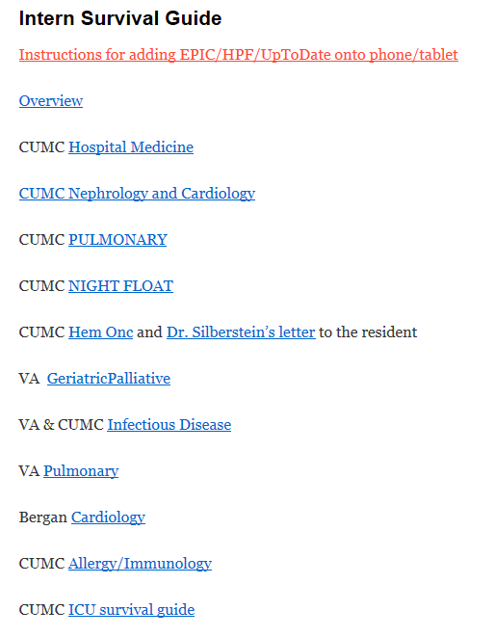
Snap shots: Creighton blog

Slide 18
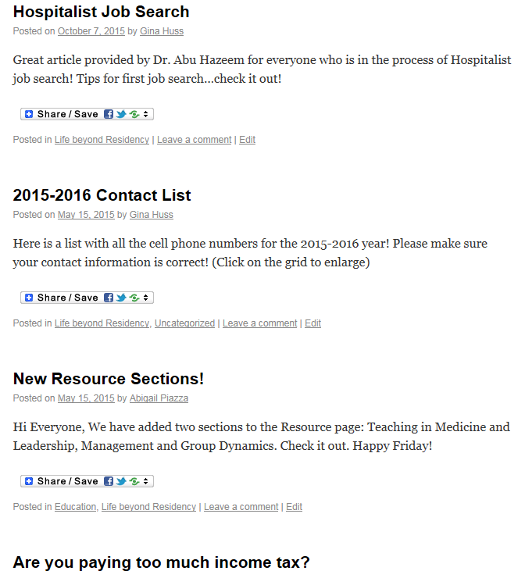
Snap shots: Creighton Blog

Slide 19
How to maintain the blog?
Have a couple lead chiefs
Update weekly
Aim for 3 posts per week
Get buy in from fellow residents
Send short emails with hyperlink to blog

Slide 20
Challenges
Creating the time
Implementing the blog
Keeping up with posts
Creating content for posts
Holiday lulls

Slide 21
Data views per month 2014-2015

Slide 22
Data views per month 2015/2016

Slide 23
Questions?
Contact information:
ginahuss@creighton.edu
mohsin.mirza@creighton.edu

Slide 24
Credits
Dr. Maryam Gbadamosi-Akindele, Ambulatory Chief 2014-2015 Creighton Blog Creator
Drs. Juan Lessing, Sylvia Mollerstrom University of Washington Chiefs 2014-2015
Dr. Tammy Wichman, Program Director
Josh Wester, Megan Schrage Creighton IT

Slide 26
ABOUT
CONFERENCES
52 in 52
EKG of the WEEK
QUALITY (of life) IMPROVEMENT
182x residents in program
3x training sites
11x chief residents
1x WordPress blog maintained by chiefs

Slide 27
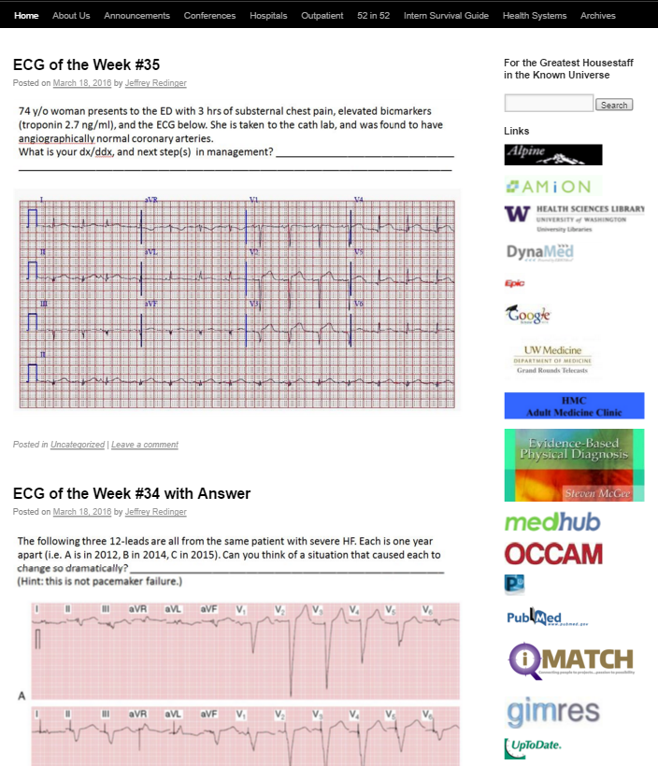
ABOUT
CONFERENCES
52 in 52
EKG of the WEEK
QUALITY (of life) IMPROVEMENT
Clinical resources

Slide 28
ABOUT
CONFERENCES
52 in 52
EKG of the WEEK
QUALITY (of life) IMPROVEMENT
Blog hosted on internal university server
1500-2000x page views per month

Slide 29
ABOUT
CONFERENCES
52 in 52
EKG of the WEEK
QUALITY (of life) IMPROVEMENT
Blog hosted on internal university server
1500-2000x page views per month
Mostly clinical content
Some novel surprises

Slide 30
ABOUT
CONFERENCES
52 in 52
EKG of the WEEK
QUALITY (of life) IMPROVEMENT

Slide 31
ABOUT
CONFERENCES
52 in 52
EKG of the WEEK
QUALITY (of life) IMPROVEMENT

Slide 32
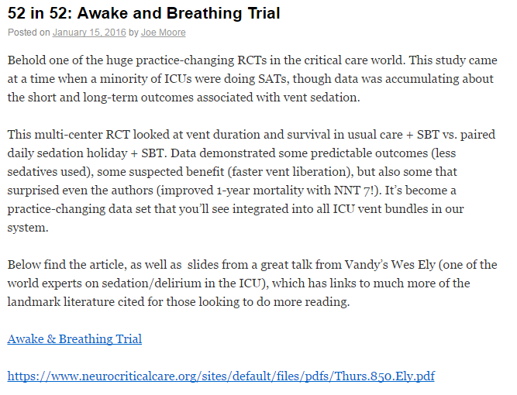
ABOUT
CONFERENCES
52 in 52
EKG of the WEEK
QUALITY (of life) IMPROVEMENT

Slide 33
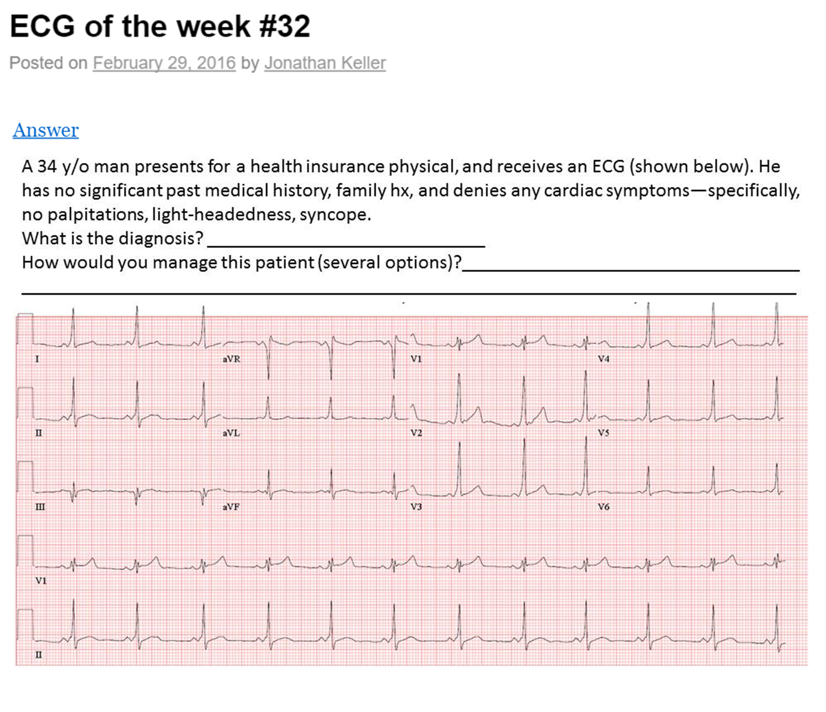
ABOUT
CONFERENCES
52 in 52
EKG of the WEEK
QUALITY (of life) IMPROVEMENT

Slide 34
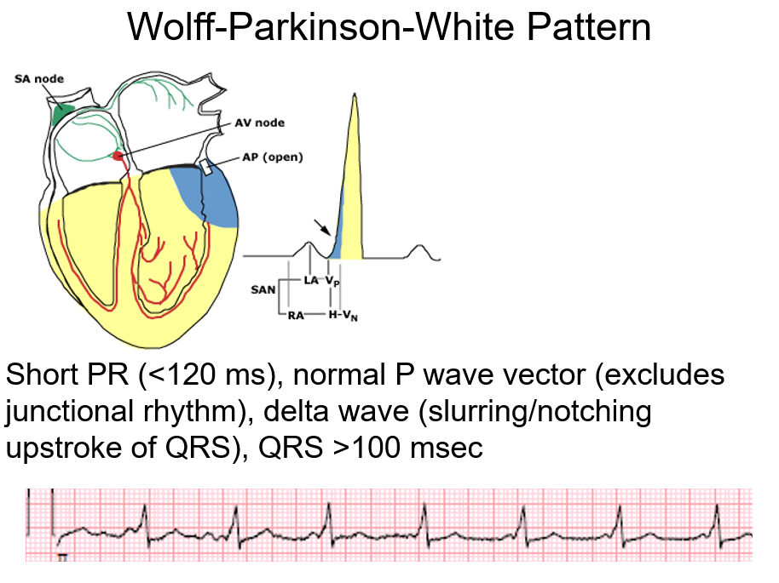
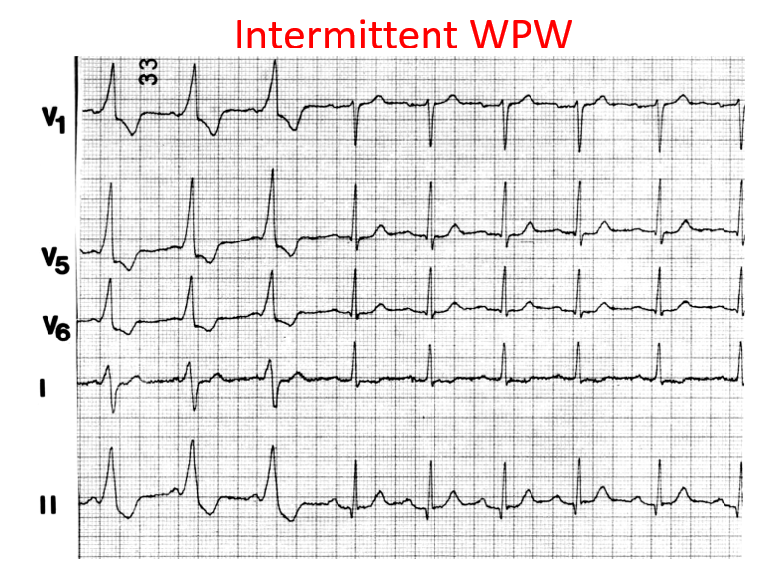
ABOUT
CONFERENCES
52 in 52
EKG of the WEEK
QUALITY (of life) IMPROVEMENT

Slide 35
ABOUT
CONFERENCES
52 in 52
EKG of the WEEK
QUALITY (of life) IMPROVEMENT
New feature launched this year focusing on wellness and life outside the hospital
Hope was also to boost traffic

Slide 36
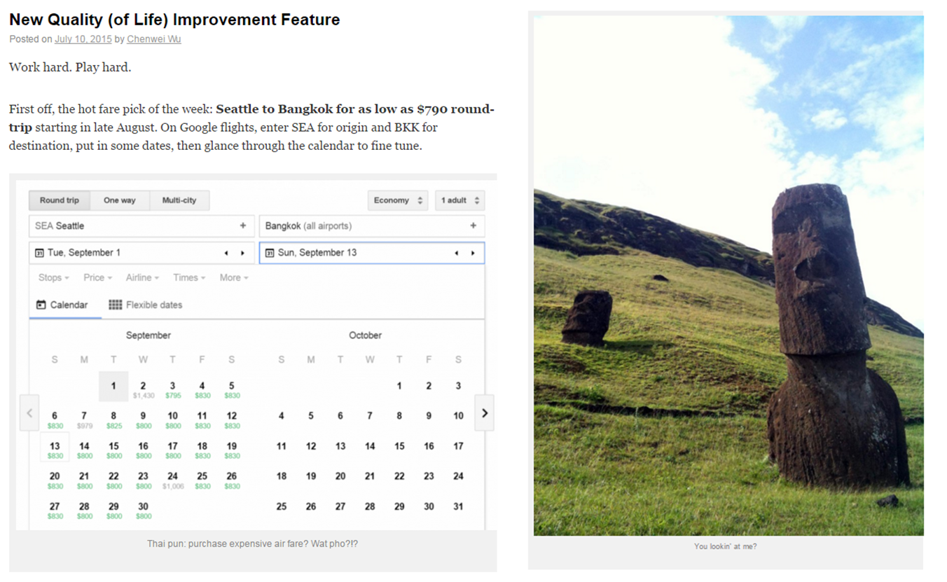
ABOUT
CONFERENCES
52 in 52
EKG of the WEEK
QUALITY (of life) IMPROVEMENT

Slide 37
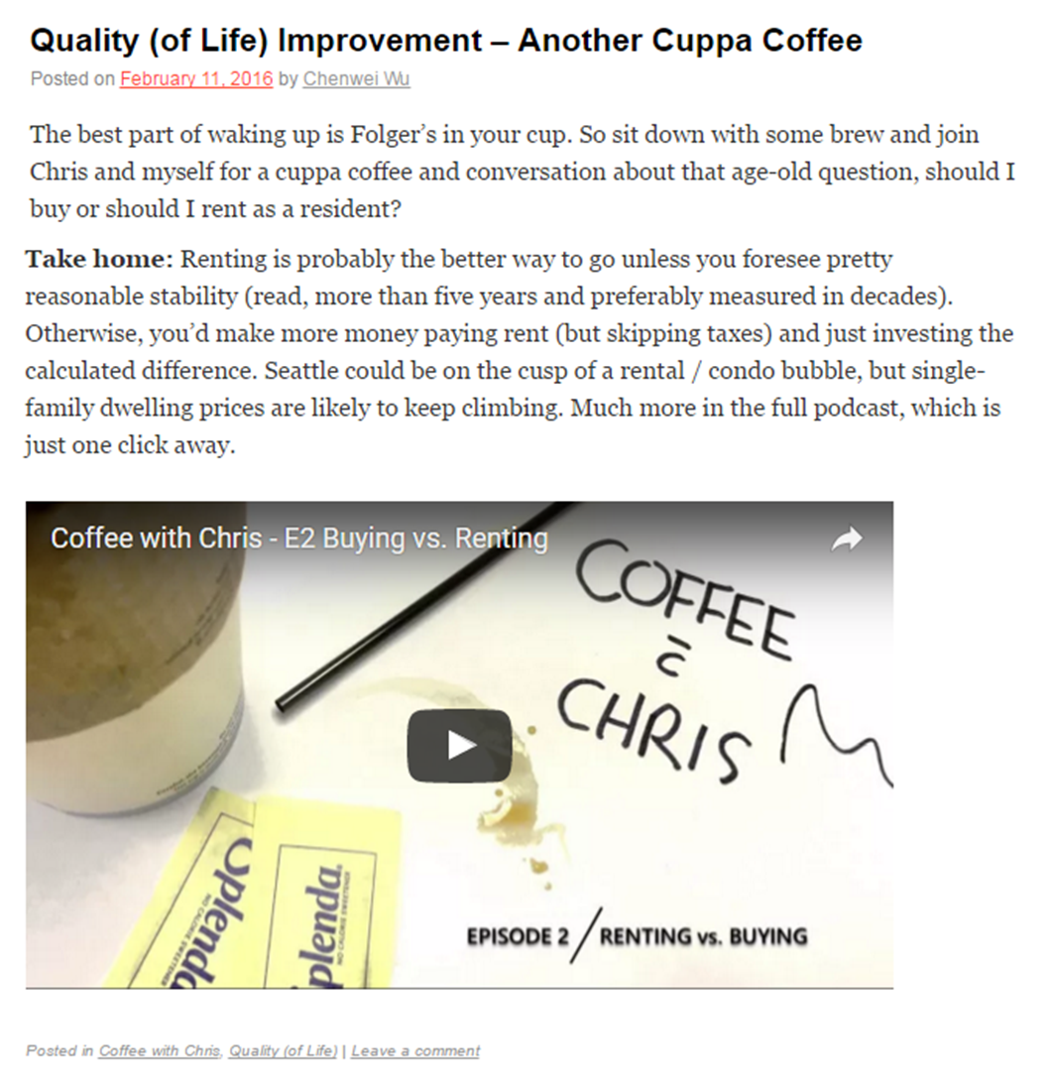
ABOUT
CONFERENCES
52 in 52
EKG of the WEEK
QUALITY (of life) IMPROVEMENT

Slide 38
ABOUT
CONFERENCES
52 in 52
EKG of the WEEK
QUALITY (of life) IMPROVEMENT
Notes:
22:04

Slide 39
PLATFORMS

Slide 40
PLATFORMS

Slide 41
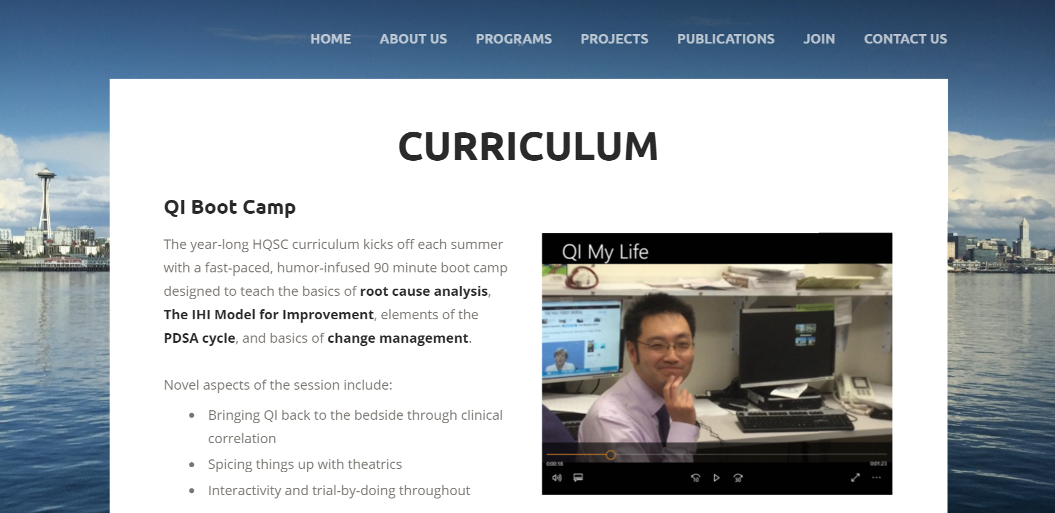
PLATFORMS

Slide 42
CHALLENGES
Need hosting space, steady content stream, and reliable bloggers to pull off
Challenge to maintain consistency over years
A lot of abandoned content

Slide 43
ACKNOWLEDGMENTS
Alisa Becker / Jehan Budak / Lindsay Collins / Leah Gordon / Jon Keller
Josh Lacsina / Joe Moore / Jeff Redinger / Jill Silvestrini / Dave Wenger
Special thanks to our webmaster Brian Valentine

Slide 44
AgileMD
Dave Ewart
Minneapolis VA Chief Resident

Slide 45
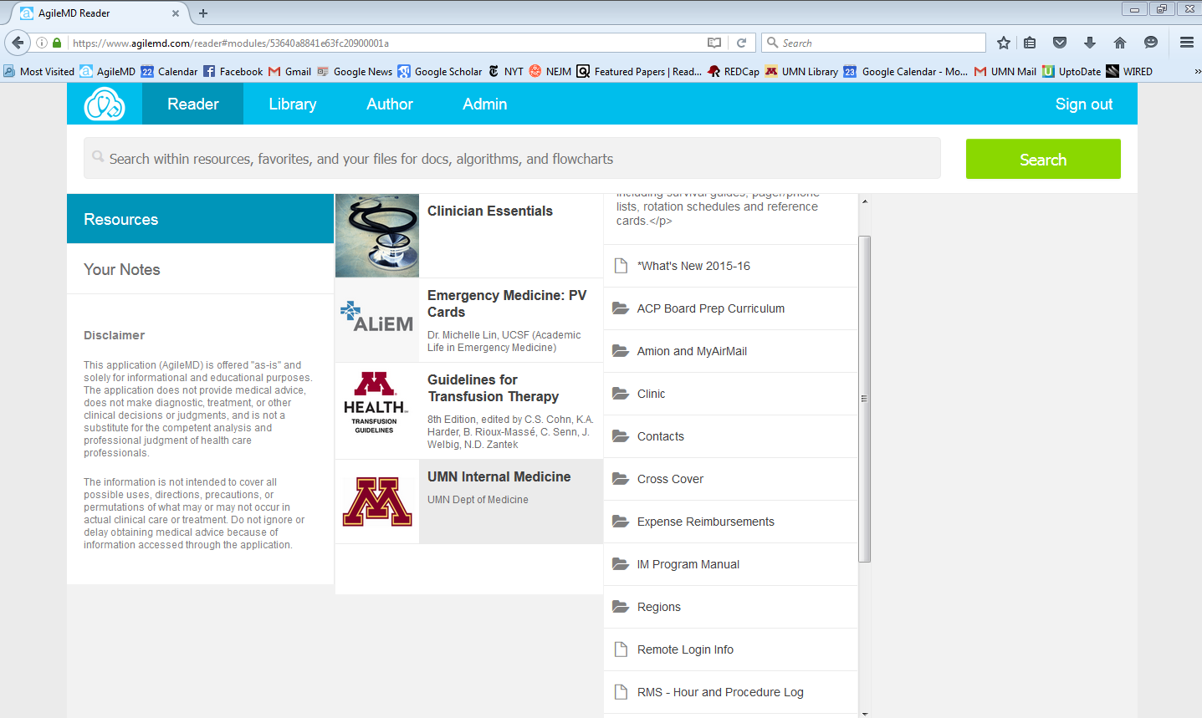

Slide 46
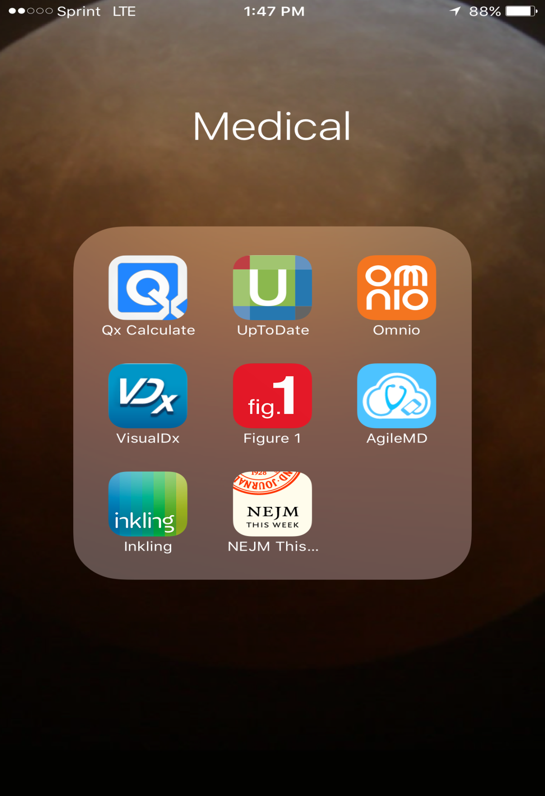
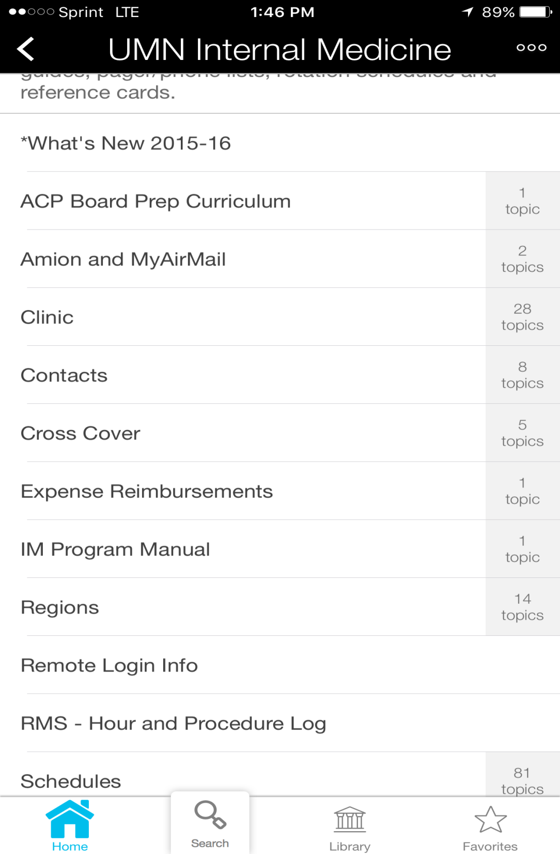

Slide 47
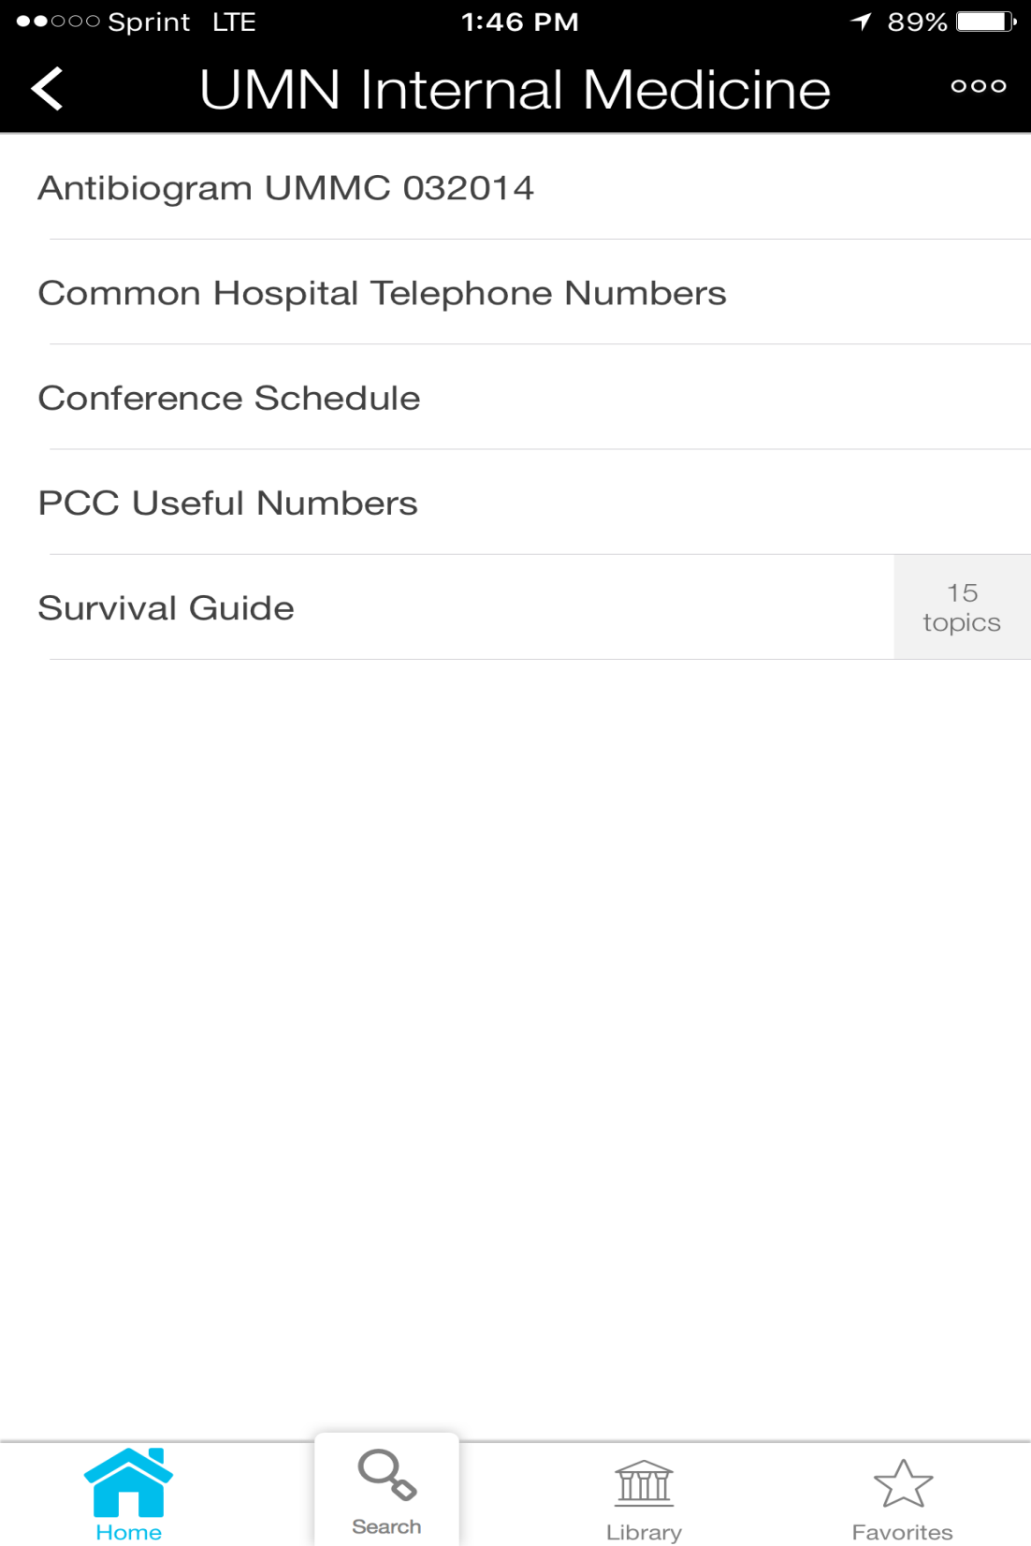
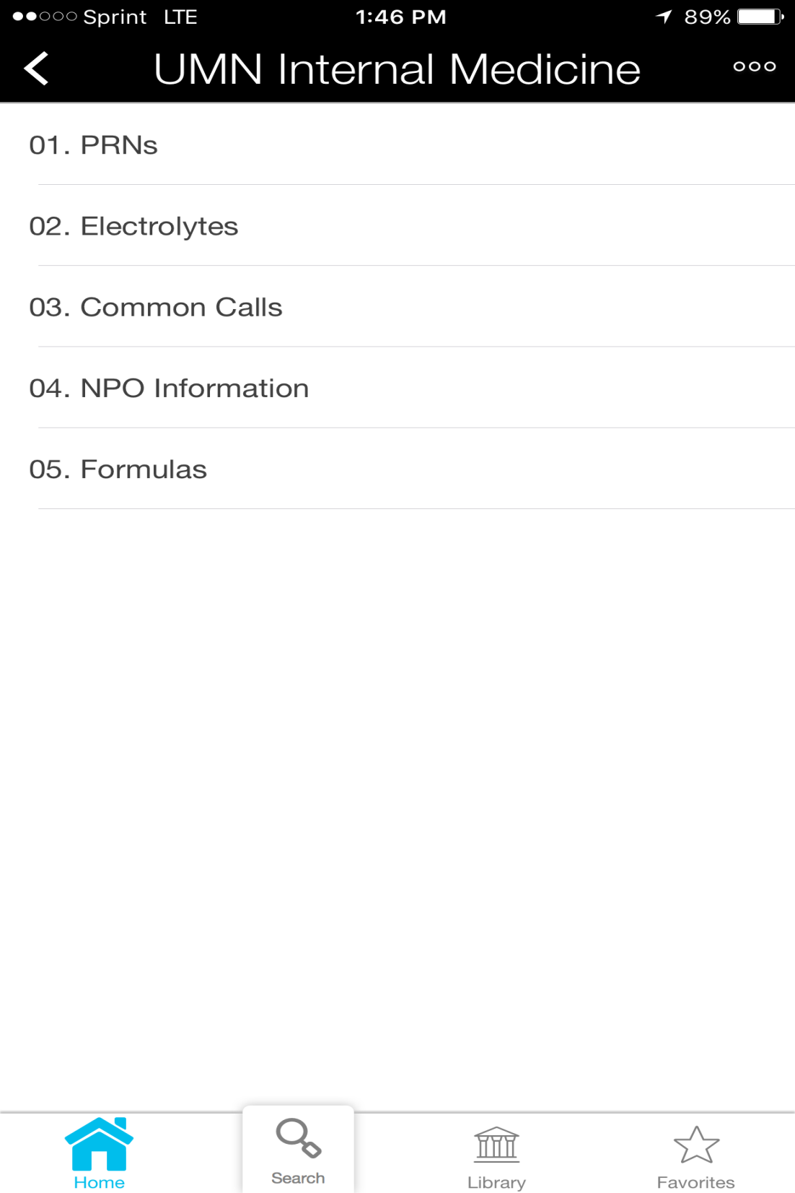

Slide 48
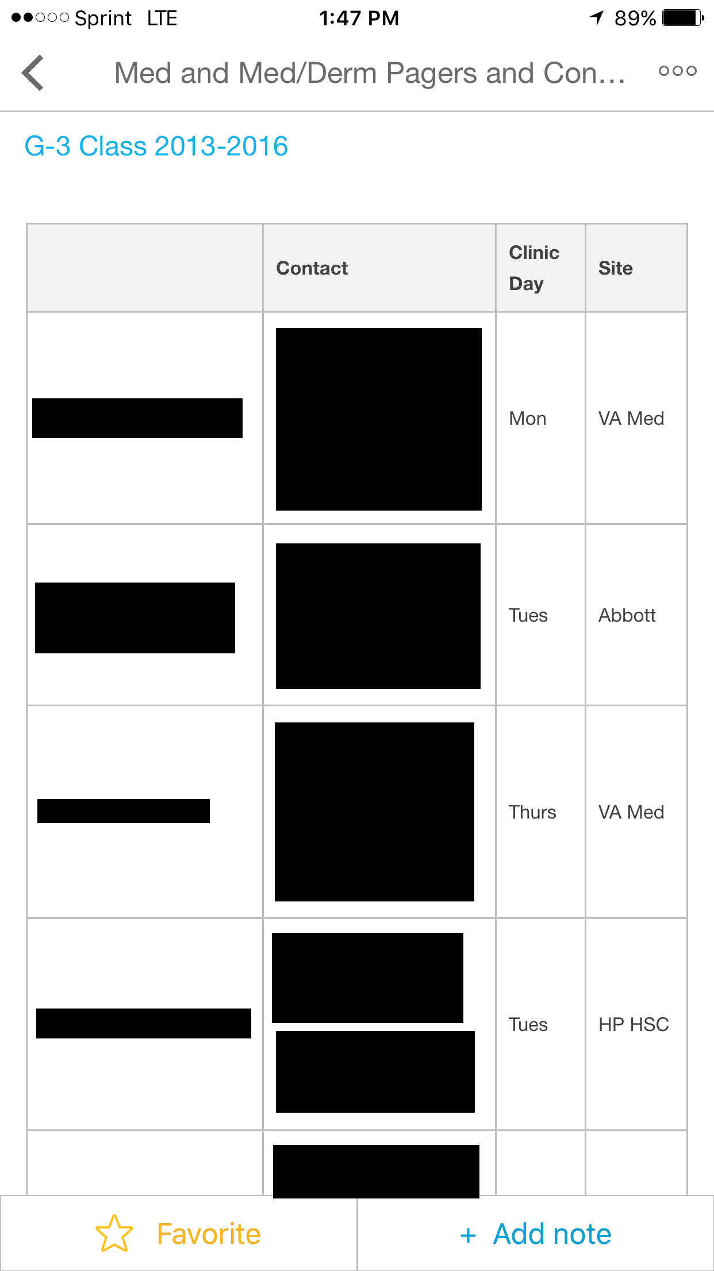

Slide 49
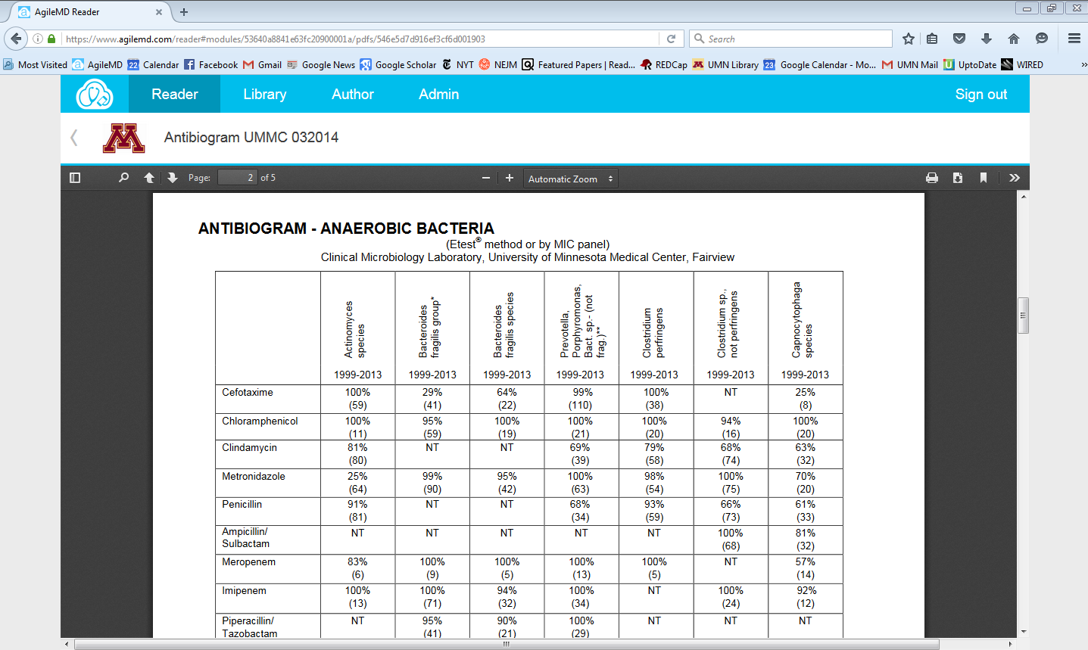

Slide 50
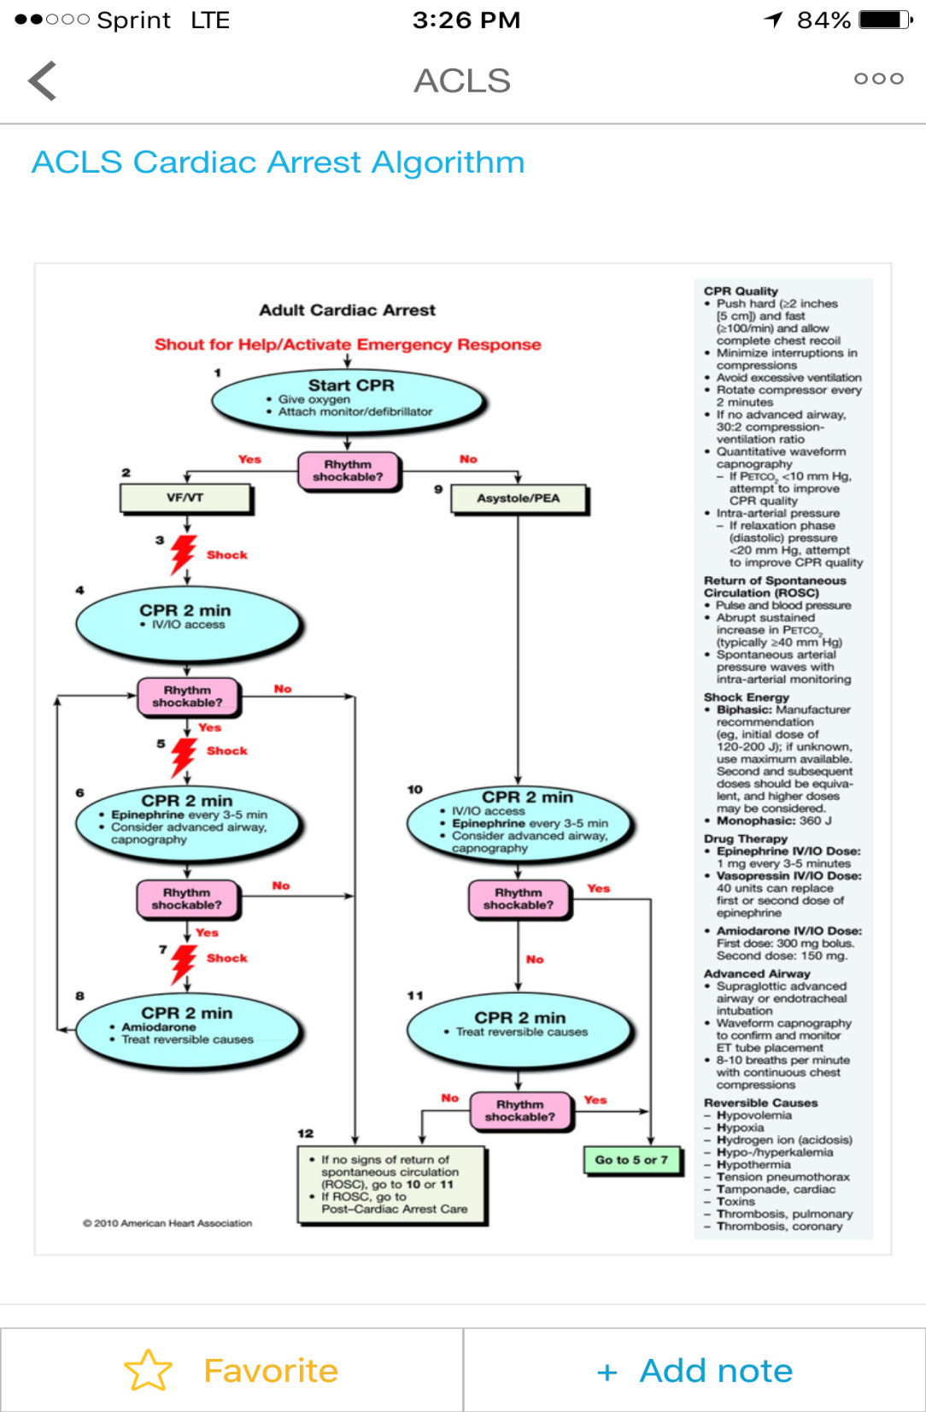
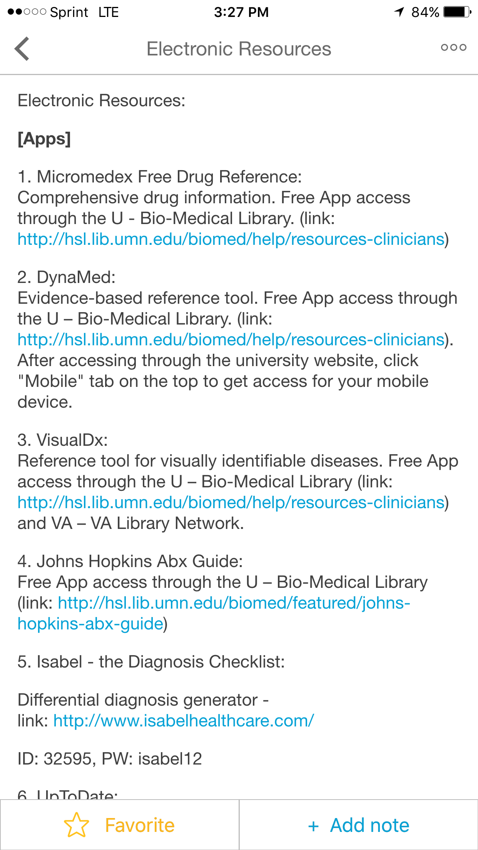

Slide 51
Pros and Cons
Pros
Cons
Information at fingertips
Mobile-friendly
Integrates with phone (calls, texts, e-mails)
No re-login required
Highly customizable
Content can be added/updated by many different people, very easy to do
Subscription fee
Lacks some functionality of blogs/wiki’s
No area for lengthy discussion-based comment
Can’t embed other websites/calculators
Not behind a university or institution-specific firewall

Slide 52
Creating a Wiki: A one-stop-shop for learners at the Boston VA
April 19th, 2016
Mark Tuttle, MD VA Chief Medical Resident Beth Israel Deaconess Medical Center
Faisal Rahman, MD VA Chief Medical Resident Boston Medical Center
More on MedicineInnovation.com

Slide 53
Electronic Resources
Resources Available to All: | Resources Unique to VA Boston
VA Pulse: Wiki sites which can be formed and maintained at any VA site Twitter: Feed of learning points YouTube: Orientation videos Screencast-O-Matic Google calendar: Call schedule, conference schedule | Peer-to-Peer Evaluations Web App Nightfloat History & Physical Feedback Web App
Available to all and require very little technical expertise | Can be emulated at your home institution, but will require some technical expertise.
Notes:
VA Pulse

Slide 54
Challenges at VA Boston (and other VAMCs)
Learners are at multiple different sites and rotations
Jamaica Plain VAMC
Primary care clinic
Outpatient neurology
West Roxbury VAMC
General Medicine Service
Medical intensive care unit
Cardiology
Multiple different institutions send residents to the Boston VA
There are many different types of learners:
Medical students
Pharmacy students
Physician assistant students
Nursing students
Interns
Residents

Slide 55
33 medical residents, 8 students (MD, PA, pharmacy)
7 home institutions
Week 1
Week 2
Week 3
Different start dates

Slide 56
A problem: Duplication of efforts
Orientation
FAQs
Logistics
Beth Israel Deaconess
“Survival Guides”
Brigham & Women’s
Logistics
Orientation
FAQs
“Survival Guides”
Boston Medical Center
“Survival Guides”
Logistics
FAQs
Orientation
Orientation
FAQs
Harvard Medical School
Logistics
“Survival Guides”

Slide 57
The solution: A single resource for many institutions
Beth Israel Deaconess
Brigham & Women’s
wikirox.com
Harvard Medical School
Boston Medical Center

Slide 58
WikiRox.com: A confluence of multiple resources
Call Schedule
Educational Conference Schedule
Quick Learning Points
wikirox.com
Phonebook
Frequently Asked Questions
Discharge Planning
How to use CPRS

Slide 59
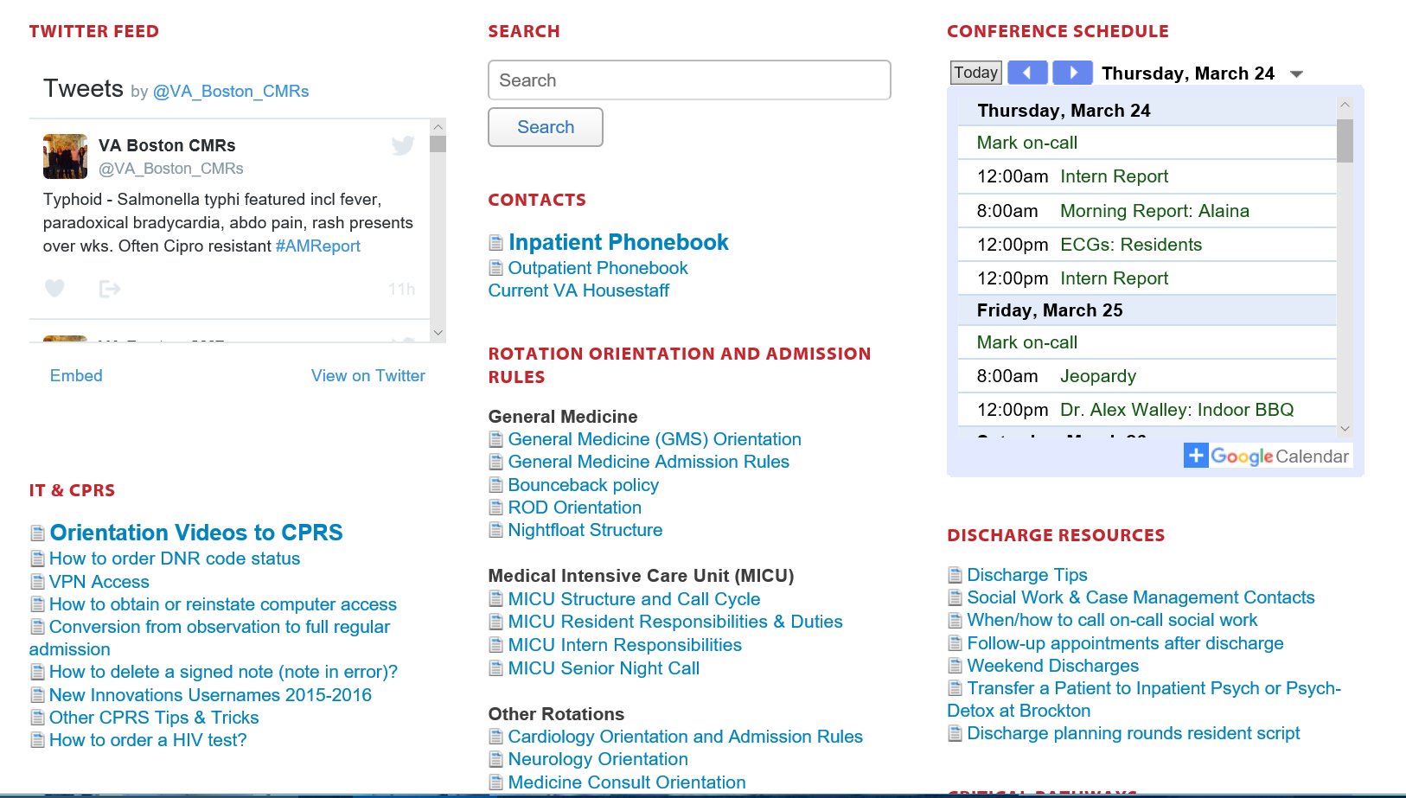
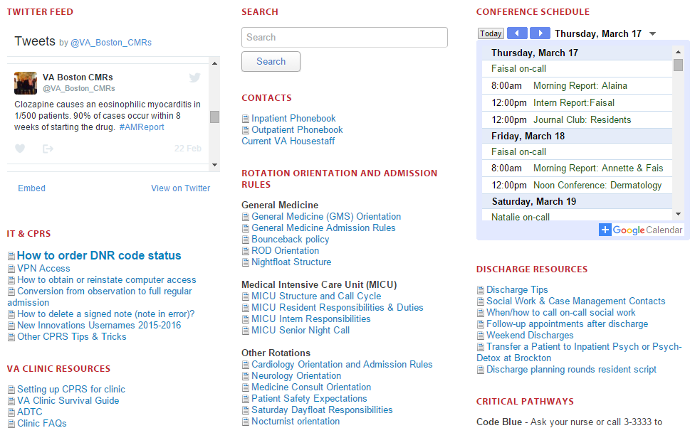
Twitter
Google Calendar
Maintained by CMRs
YouTube
Maintained by social workers
Notes:
A portal “one-stop-shop” for all trainees coming to VA Boston
Wiki structure enables decentralized maintenance of sections of the site by users (no single user needs to be responsible for all content)
Able to embed content from other electronic resources displayed here
Twitter
Google Calendar

Slide 60
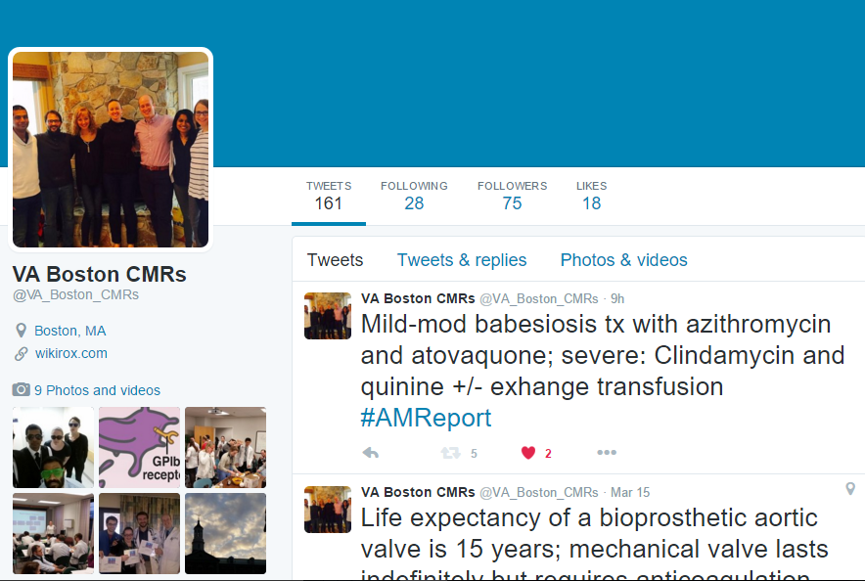
Twitter: Follow us! VA Boston CMRs

Slide 61
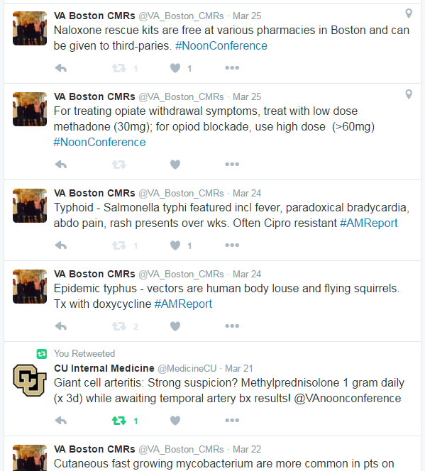

Slide 62
Twitter
Google Calendar
Maintained by CMRs
YouTube
Maintained by social workers
Notes:
A portal “one-stop-shop” for all trainees coming to VA Boston
Wiki structure enables decentralized maintenance of sections of the site by users (no single user needs to be responsible for all content)
Able to embed content from other electronic resources displayed here
Twitter
Google Calendar

Slide 63
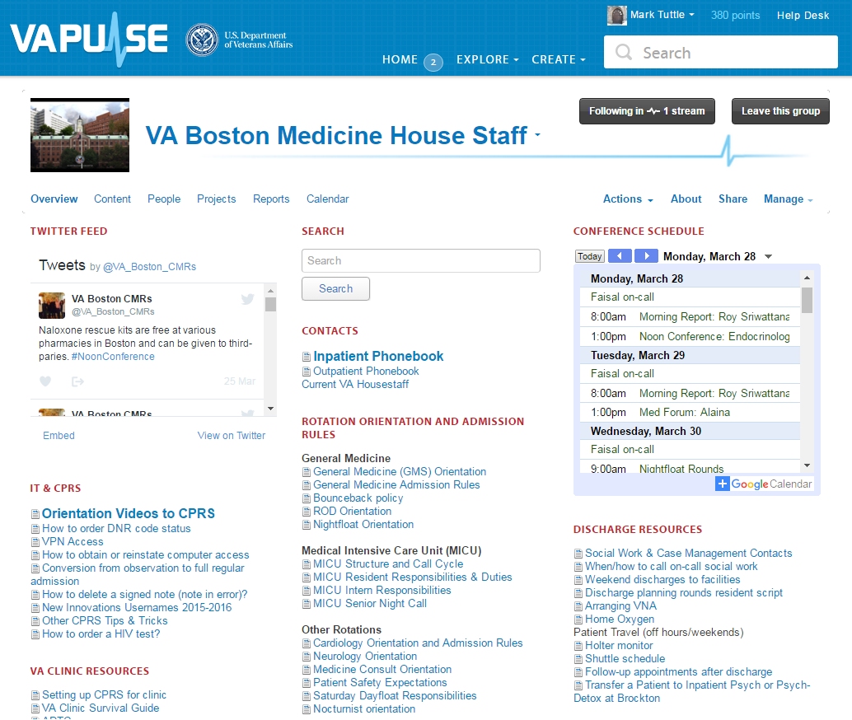
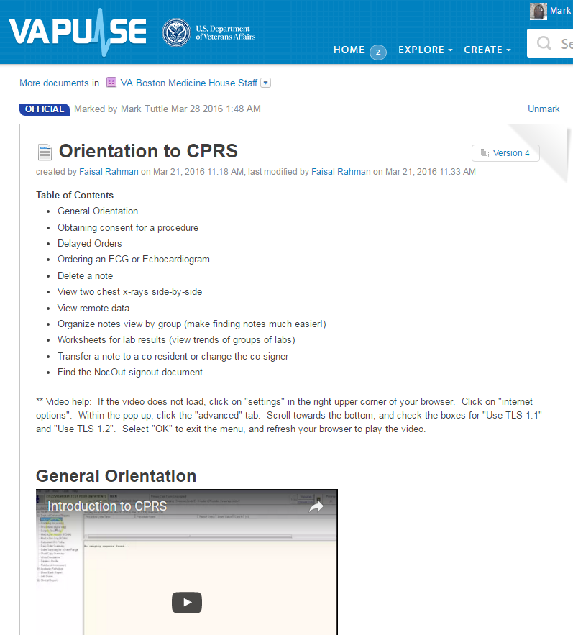

Slide 64
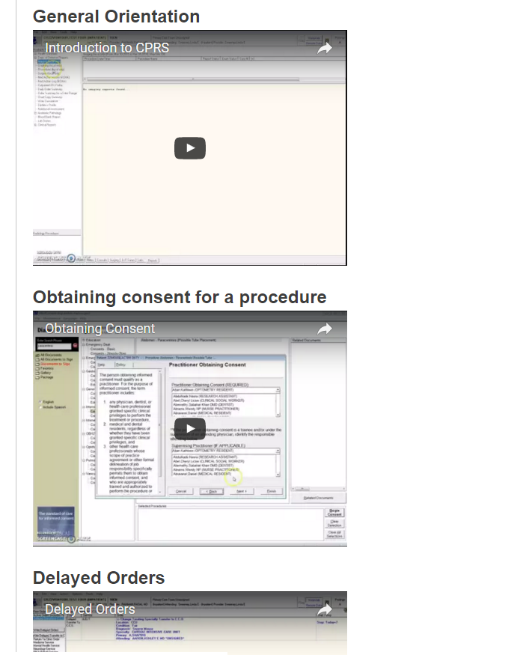

Slide 65
Screencast-O-Matic – Hosted on YouTube, embedded on wikirox.com

Slide 66
Twitter
Google Calendar
Maintained by CMRs
YouTube
Maintained by social workers
Notes:
A portal “one-stop-shop” for all trainees coming to VA Boston
Wiki structure enables decentralized maintenance of sections of the site by users (no single user needs to be responsible for all content)
Able to embed content from other electronic resources displayed here
Twitter
Google Calendar

Slide 67
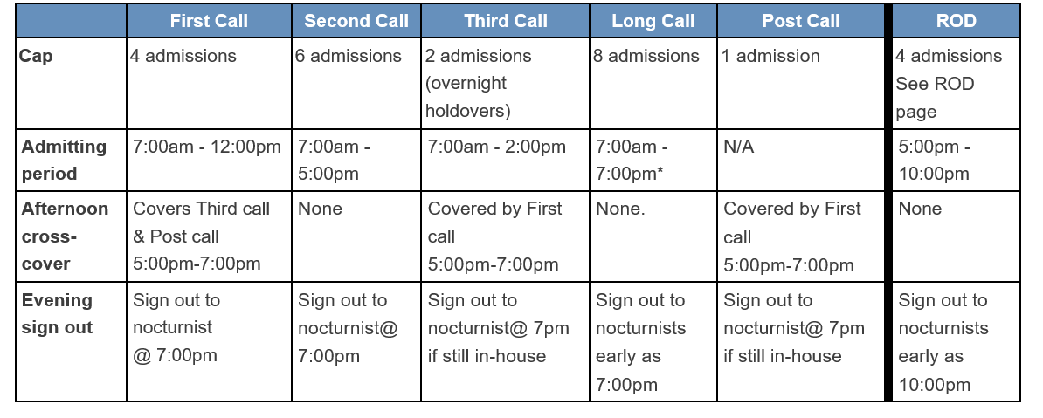
Admitting scheme

Slide 68
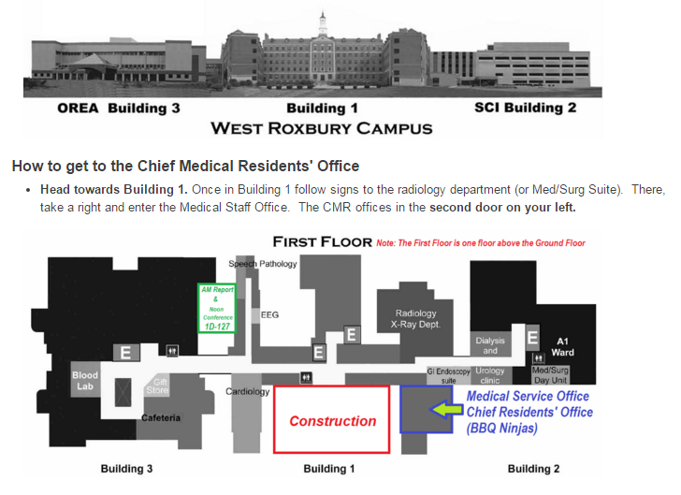
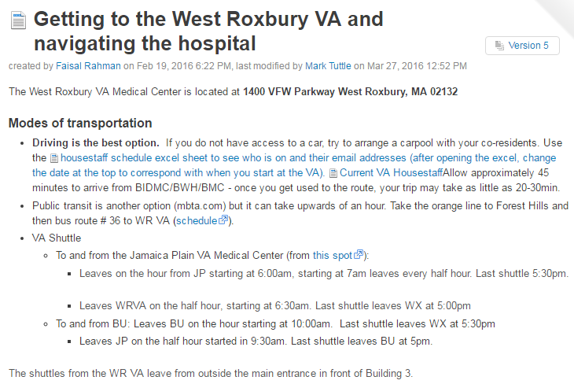
Logistics

Slide 69
Twitter
Google Calendar
Maintained by CMRs
YouTube
Maintained by social workers
Notes:
A portal “one-stop-shop” for all trainees coming to VA Boston
Wiki structure enables decentralized maintenance of sections of the site by users (no single user needs to be responsible for all content)
Able to embed content from other electronic resources displayed here
Twitter
Google Calendar

Slide 70
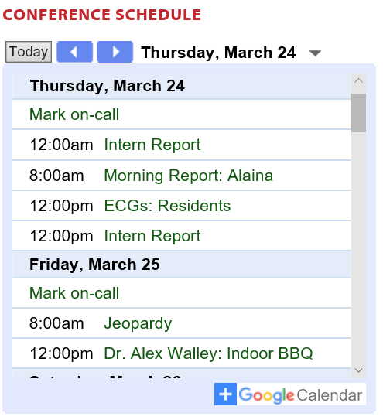
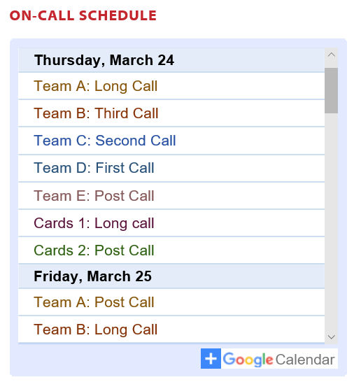
Google Calendar Integration

Slide 71
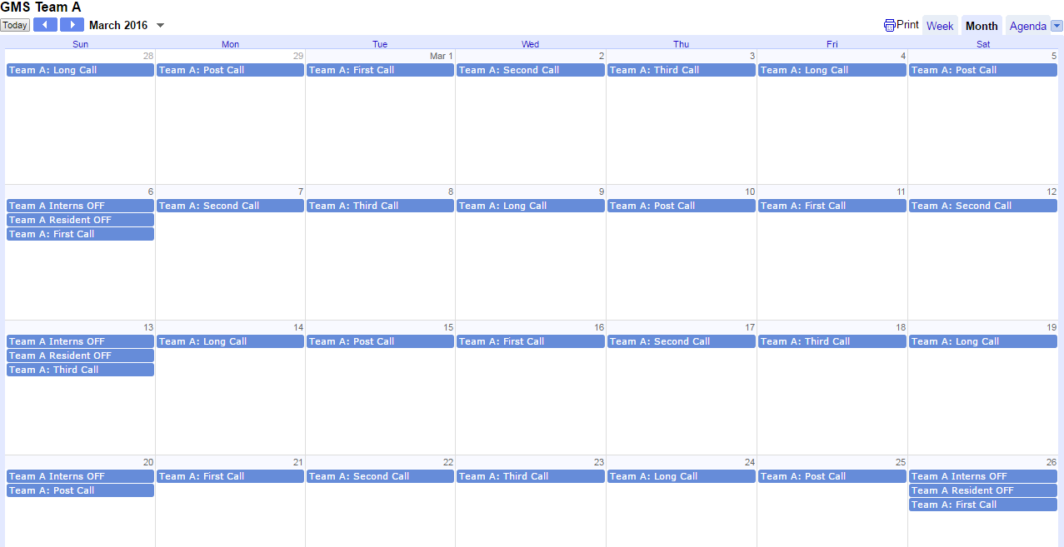
Google Calendar Integration

Slide 72
Twitter
Google Calendar
Maintained by CMRs
YouTube
Maintained by social workers
Notes:
A portal “one-stop-shop” for all trainees coming to VA Boston
Wiki structure enables decentralized maintenance of sections of the site by users (no single user needs to be responsible for all content)
Able to embed content from other electronic resources displayed here
Twitter
Google Calendar

Slide 73
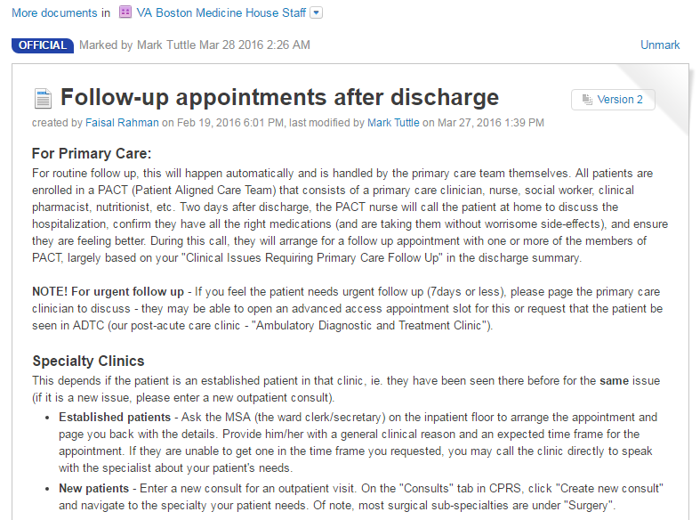
Discharge Planning: Maintained by social workers

Slide 74
wi·ki
ˈwikē/
noun
a website that allows collaborative editing of its content and structure by its users.

Slide 75
Notes:
A portal “one-stop-shop” for all trainees coming to VA Boston
Wiki structure enables decentralized maintenance of sections of the site by users (no single user needs to be responsible for all content)
Able to embed content from other electronic resources displayed here
Twitter
Google Calendar

Slide 76
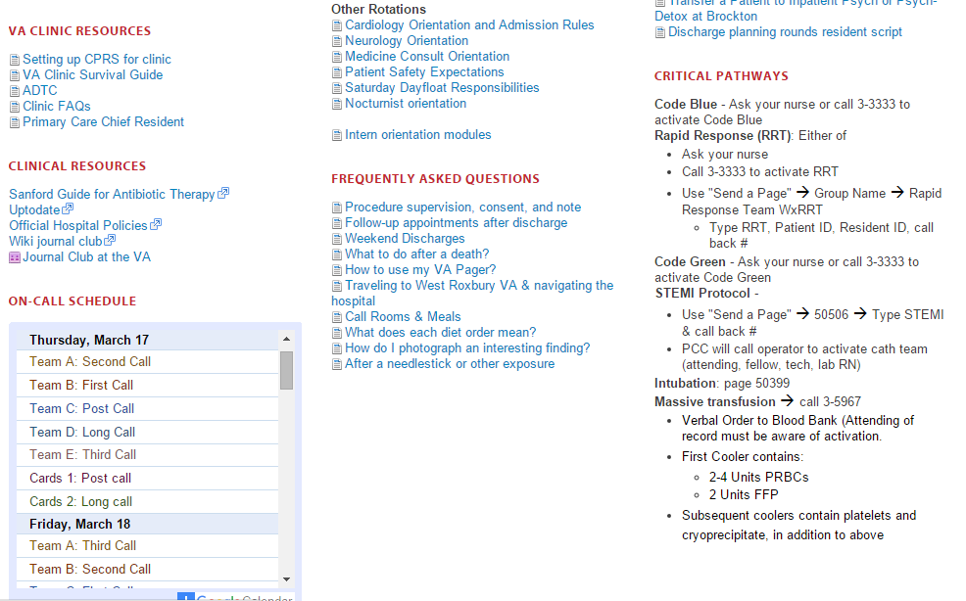
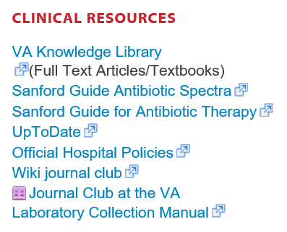

Slide 78
Electronic Resources
Resources Available to All: | Resources Unique to VA Boston
VA Pulse: Wiki sites which can be formed and maintained at any VA site Twitter: Feed of learning points YouTube: Orientation videos Screencast-O-Matic Google calendar: Call schedule, conference schedule | Peer-to-Peer Evaluations Web App Nightfloat History & Physical Feedback Web App
Available to all and require very little technical expertise | Can be emulated at your home institution, but will require some technical expertise.
Notes:
VA Pulse

Slide 79
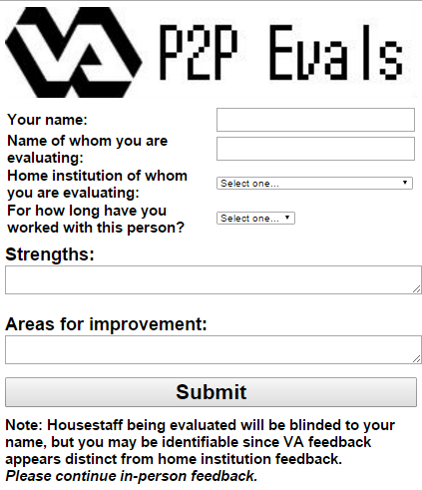
Peer-to-peer Evaluations
Web app
Accessible on any mobile device, computer
Residents fill the form at the end of a teaching conference
Notes:
http://hmdi.osowebstudio.netdna-cdn.com/images/stories/doctor_with_cell_phone.jpg
We ask our trainees to take their phones out and fill this out and the end of Thursday teaching conference when the interns and residents are in separate teaching conferences.

Slide 80
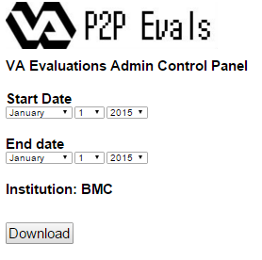
Peer-to-peer Evaluations Admin Panel
Password protected
Each institution has administrative login - download evaluations of their trainees en masse
Can be imported into programs like New Innovations

Slide 81
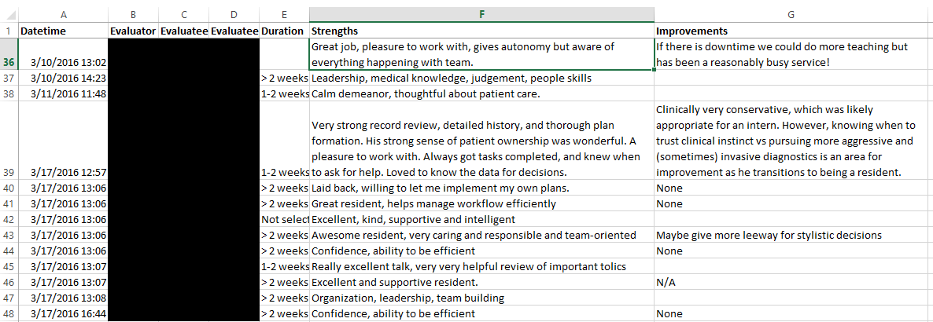
Peer-to-peer Evaluations Output: Microsoft Excel

Slide 82
How to replicate our success at your institution
These links are available on: MedicineInnovation.com
Create your own website
Jive: Free through the VA (VAPulse.net)
Wix: Free (Example: http://arrowheademergency.wix.com/armcemresidency)
Use free web resources
YouTube
Screen Cast-O-Matic
Google Calendar
Twitter
GoDaddy.com: To buy a domain name (ex. WikiRox.com, $7/year)

Slide 83
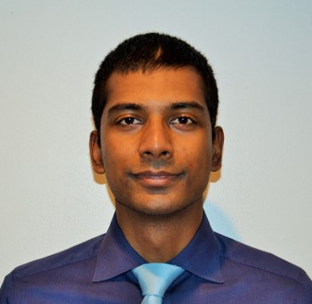
We are Happy to Help!
Mark Tuttle
Faisal Rahman
Beth Israel Deaconess Med. Center
VA Boston Chief Medical Resident
Former Senior Web Developer
Mark.Tuttle@va.gov
Boston Medical Center
VA Boston Chief Medical Resident
Technophile
Faisal.Rahman@va.gov

